Slide 1
Self Organizing List & Unrolled Linked List

Slide 2
Self Organizing List,
The worst case search time for a sorted linked list is O(n).
One idea to make search faster for Linked Lists is Skip List. Another idea (which is discussed in this post) is to place more frequently accessed items closer to head.
A Self Organizing list reorders its nodes based on searches which are done. The idea is to use locality of reference (In a typical database, 80% of the access are to 20% of the items).

Slide 3
Different strategies used by Self Organizing Lists.
Move-to-front method: After locating the search element it is moved to the logical front of the list.
Transpose method: After the search element is located, it is swapped with its predecessor element.
Count method: The order of the elements in the list is maintained based upon the number of times the element is referenced.
Ordering method: The order of the list is maintained using some criteria which is pertinent to the information maintained in the list. In other words, some natural ordering of the data based upon some search protocol.

Slide 4
Move-to-front Method

Slide 5
Transpose Method

Slide 6
Count Method
The count method requires that a counter be associated with each element in the list which records the number of accesses to that element.
The list is maintained in the order of most number of accesses down to the least number of accesses.
In the event of a tie between two or more elements with the same number of accesses, the tie is typically broken arbitrarily.

Slide 7
Ordering Method
The organizational criteria for this method can be any which are suitable for the data/information maintained in the list.

Slide 8
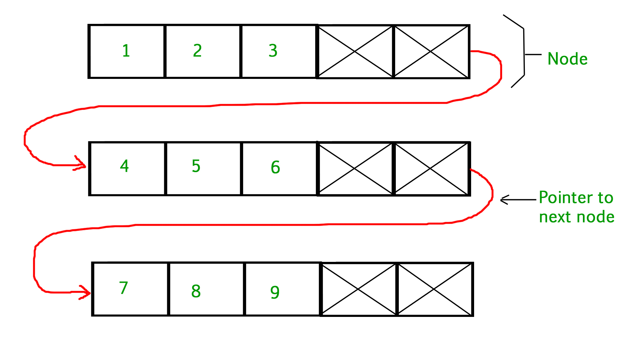
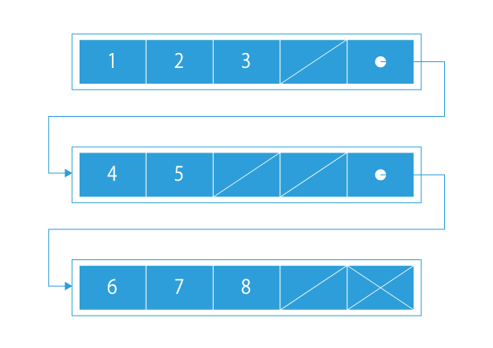
Unrolled Linked List
An Unrolled Linked List is a type of linked list that can store multiple elements at a single reference location, i.e., at each node, we can store multiple elements together.
#define MAX_SIZE 50
struct Node{
int noOfElements; // number of elements in this node, upto maximum elements
Node* next; // reference to next node
int elements[MAX_SIZE]; // this array will contain noOfElements, however space is reserved for MAX_SIZE
};

Slide 9
Why do We Need Unrolled Linked List?
We are already aware of the advantages that Linked List gives us over arrays but Unrolled Linked List combine the advantage of the array (small memory overhead) along with the advantage of linked lists like fast insertion and deletion.
By storing multiple elements at each node, unrolled linked list offers advantage of linked list across multiple elements.
For example : If an unrolled linked list stores an array of 5 elements at each node, it will offer the same advantage (because of pointers) across those 5 elements. Thus it covers advantage of both arrays and linked list.
Faster performance when you consider cache management.

Slide 10
Advantages
Faster Linear Search as compared to Original Linked List due to cache friendliness.
Requires less space for pointer as compared to original linked list.
Traversal, Insertion and Deletion is much faster as compared to original Linked List.
Disadvantage
A fairly high overhead per node when compared to the singly linked list, since for every node it can store an array of elements

Slide 11
Efficient Searching
We have total 10 elements spread over 3 nodes and thus distribution can be 3 3 4 elements respectively in each node. Now, if we are required to find 8th element, we will traverse only the last block of the node. Thus searching can also be efficient in such a way.

Slide 12
Implementation of unrolled Linked List
Each node in the unrolled linked list contains three types of information:
an array containing values,
array length, and
the pointer to the next node.
Each array in a node can hold a certain number of elements.
Let us call it the capacity. However, typically, it is not filled to its maximum capacity. Generally, the length of each array in a node is equal to the minimum threshold, i.e.,
Minimum threshold = capacity/2 (integer division)
Moreover, the unrolled linked list has two pointers: head and tail. Head points to the first node, and tail refers to the last node.

Slide 13
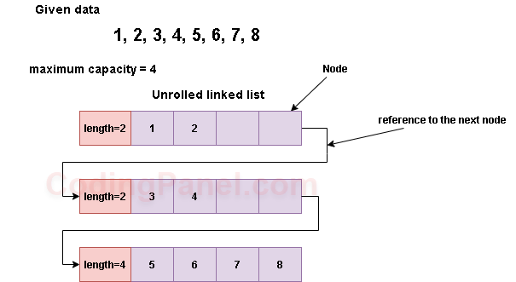
Insertion
Insert (ElementToBeInserted)
if start_pos == NULL
Insert the first element into the first node
start_pos.numElement ++
end_pos = start_pos
If end_pos.numElements + 1 < node_size
end_pos.numElements.push(newElement)
end_pos.numElements ++
else
create a new Node new_node
move final half of end_pos.data into new_node.data
new_node.data.push(newElement)
end_pos.numElements = end_pos.data.size / 2 + 1
end_pos.next = new_node
end_pos = new_node

Slide 14
Deletion
The operation of the deletion is the opposite of insertion.
First, we find the first appearance of the given value and remove it from the array.
After the removal, if the current node’s length is less than 50% of the maximum capacity, we move elements from the next node to the current node till that condition is not satisfied.
We also check if the next node’s length is less than 50% of the maximum capacity.
If it is, then we merge the current node and the next node.
If the value does not exist in the list, then we throw an error.
Delete(element)
Find element in node e
e.data.remove(element)
e.numElements --
while e.numElements < e.data.size / 2
put element from e.next.data in e.data
e.next.numElements --
e.numElements ++
if e.next.numElements < e.next.data.size / 2
merge nodes e and e.next
delete node e.next

Slide 15
Search
/* Function to traverse am unrolled linked list
and print all the elements*/
void printUnrolledList(struct Node *n)
{
while (n != NULL)
{
// Print elements in current node
for (int i=0; i<n->numElements; i++)
printf("%d ", n->array[i]);
// Move to next node
n = n->next;
}
}

Slide 16
Time Complexity
Unrolled linked lists are difficult to analyze because they are implemented in so many different ways and with some many different variations depending on data.
Time
To insert an element, you must first find the node in which you want to insert. This is O(n).
If that node is not full, you are done. If it is full, you must create a new node and move values over.
This process does not depend on total values in the linked list, so it is constant time.
Deletion works the same way, in the reverse fashion

